Slide 1
Acceptability Judgements on
Contrastive Dialogues
Involving ellipsis
Master’s thesis
Supervisors:
Prof. Dr. Michael Franke
Jun.-Prof. Dr. James Griffiths
Miriam Schiele
**DATUM***

Slide 2
Research Question & Hypotheses
Study design
Results and revisiting hypotheses
Discussion
Background
The Influence of Metaphors
Contrastive Dialogues involving ellipsis

Slide 3
Background
A: Peter worked at the cinema FROM 6pm
B: No, UNTIL 6pm

Slide 4
Background
A: Peter worked at the cinema FROM 6pm
B: No, UNTIL 6pm
Fragment
remnant of ellipsis
Griffiths et al., 2023

Slide 5
Background
A: Peter worked at the cinema FROM 6pm
B: No, Peter worked at the cinema UNTIL 6pm

Slide 6
Background
A: Peter worked at the cinema FROM 6pm
B: No, Peter worked at the cinema UNTIL 6pm
Licensing condition
only given material can be omitted
Winkler, 2019; Merchant, 2001

Slide 7
Background
A: Mary stole the cookie
B: No, Peter

Slide 8
Background
A: Mary stole the cookie
B: No, [Peter]_{F}
Contrastive focus F
given alternative elements for which the predicate actually holds, must bear pitch accent
Griffiths & Lipták, 2014; Krifka, 2008; Winkler, 2019

Slide 9
Background
A: Mary stole the cookie
B: No, Peter
assign category to remnant
find correlate in antecedent clause
construct elided phrase
Harris & Carlson, 2018

Slide 10
Background
A: Mary stole the cookie
B: No, Peter_{DP=Remnant}
assign category to remnant
find correlate in antecedent clause
construct elided phrase
Harris & Carlson, 2018

Slide 11
Background
A: Mary_{DP=Correlate} stole the cookie
B: No, Peter_{DP=Remnant}
assign category to remnant
find correlate in antecedent clause
construct elided phrase
Harris & Carlson, 2018

Slide 12
Background
A: Mary_{DP=Correlate} stole the cookie
B: No, Peter_{DP=Remnant} stole the cookie
assign category to remnant
find correlate in antecedent clause
construct elided phrase
Harris & Carlson, 2018

Slide 13
Background
Parallelism syntactic, morphological, phonological
Locality processors choose nearest correlate
Emphasis colour-coding, capitalisation
Modality natural context of fragments
X

Slide 14
Research Question
What is the most effective medium for obtaining acceptability judgements about dialogues involving contrastive focus?
similar input with more effort:
crane neck / sit up

Slide 15
Hypotheses
Emphasis
Modality
Fragment type
emphasis on contrasting words > lacking emphasis
auditory stimuli > written stimuli
lexical fragments > functional fragments

Slide 16
Hypotheses
Emphasis
Modality
Fragment type
emphasis on contrasting words > lacking emphasis
auditory stimuli > written stimuli
lexical fragments > functional fragments

Slide 17
Hypotheses
Emphasis
Modality
Fragment type
emphasis on contrasting words > lacking emphasis
auditory stimuli > written stimuli
lexical fragments > functional fragments

Slide 18
Hypotheses
Emphasis
Modality
Fragment type
emphasis on contrasting words > lacking emphasis
auditory stimuli > written stimuli
lexical fragments > functional fragments

Slide 19
Study design: Factors
Emphasis
with
Modality
auditory
Fragment type
lexical
functional
without
written

Slide 20
Study design: Stimuli
with emphasis
A: Peter showed his ID to the POLICE OFFICER.
B: No, the BOUNCER.
A: Peter showed his ID to the police officer.
B: No, the bouncer.
without emphasis

Slide 21
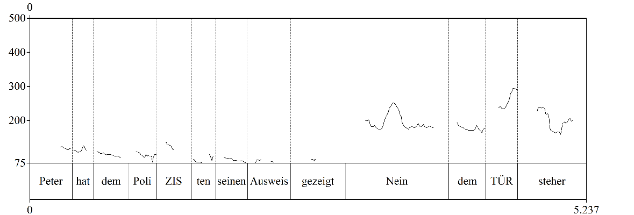
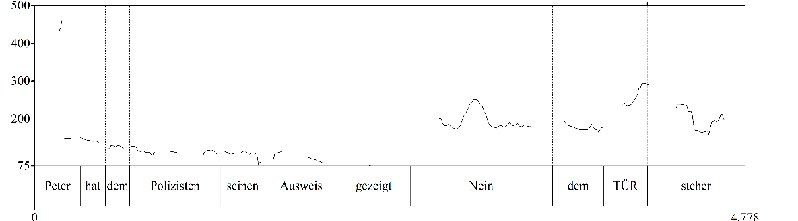
Study design: Stimuli
with emphasis
without emphasis

Slide 22
Study design: Stimuli
with emphasis
without emphasis

Slide 23
Study design: Stimuli
with emphasis
without emphasis

Slide 24
Study design: Stimuli
lexical
A: Peter showed his ID to the POLICE OFFICER.
B: No, the BOUNCER.
A: Peter worked at the cinema FROM 6pm.
B: No, UNTIL 6pm.
functional

Slide 25
Study design
modality
emphasis
fragment type
written
lexical
auditory
with emphasis
functional
without emphasis

Slide 26
Results

Slide 27
Discussion

Slide 28










Title
title
question

Slide 29
title
multiplex signals
multimodal gestalt
Comparison A
Comparison B
x
x

Slide 30
Thank you for listening!

Slide 31

Discussion

Slide 32
References
Chu, x

